Slide 1
System Allocation App

Slide 2
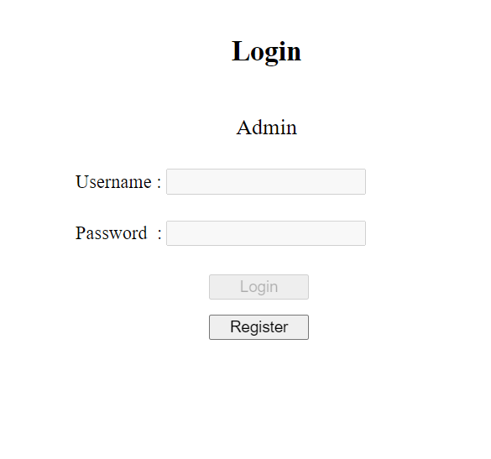
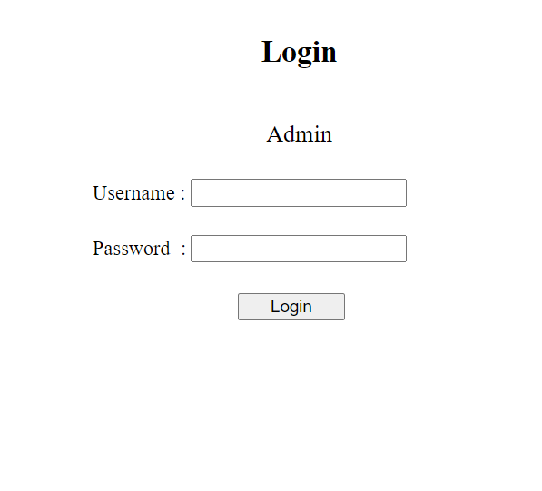
Login page
When no admin present
When at least one admin is present

Slide 3
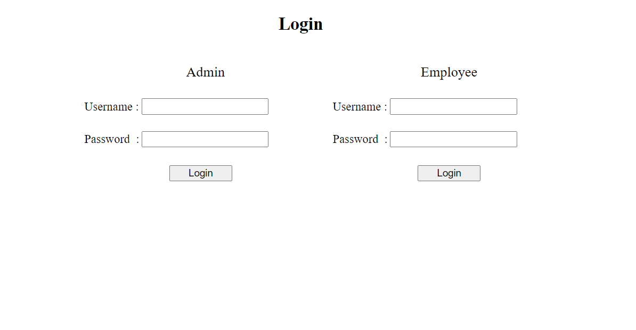
Login page
At lest one Admin and Employee present

Slide 4
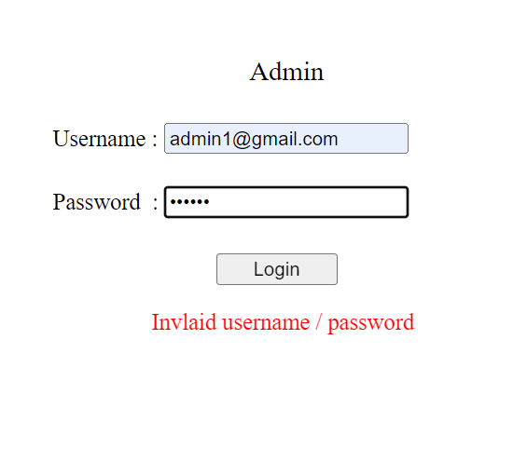
Admin Login
When incorrect username or password is entered error message is displayed in red.
When login credentials are correct Admin is redirected to Admin page and Admin ID is stored in session storage to identify which user is currently logged in to the website using that particular web browser.
Invalid username or password entered

Slide 5
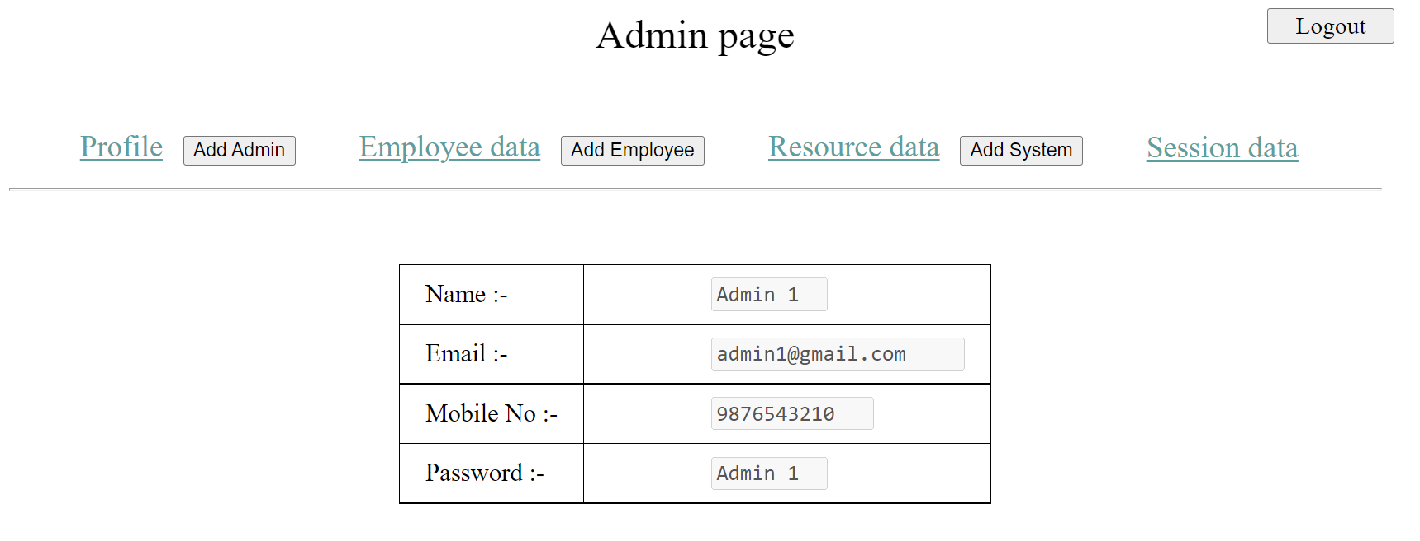
Admin page
Admin page has functionality to add, display and update data of Admin, Employee, System and Session.
Admin profile is always shown by default when logging in or refreshing the page.
Logout button can be used to log out user from web app.

Slide 6
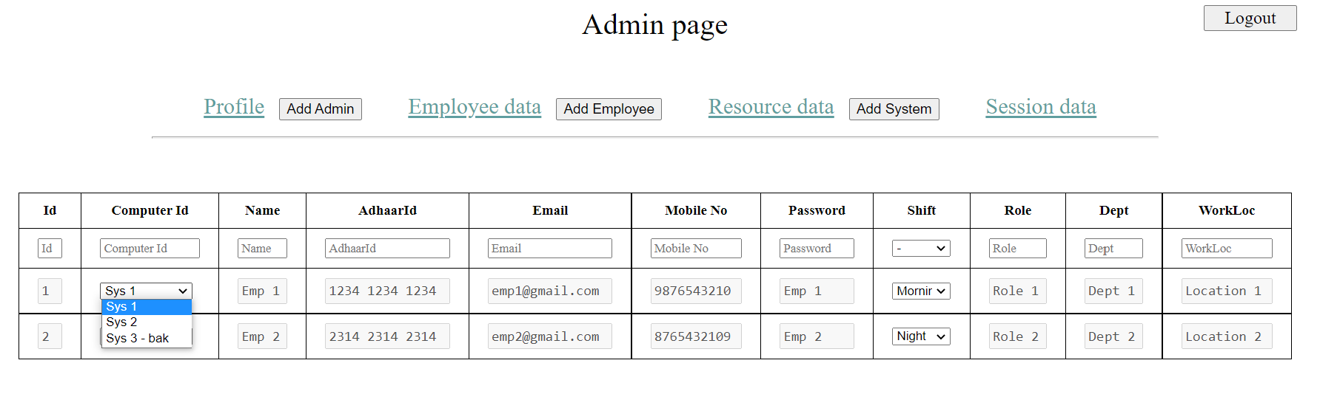
Admin – Employee data
Clicking on Employee data link will display List of all employees and their details in table format.
Employee shift can be changed from dropdown list. Changing shift will also change dropdown list of ‘Computer Id’
Employee’s allocated system can be changed from dropdown list which has list of unallocated systems including backups

Slide 7
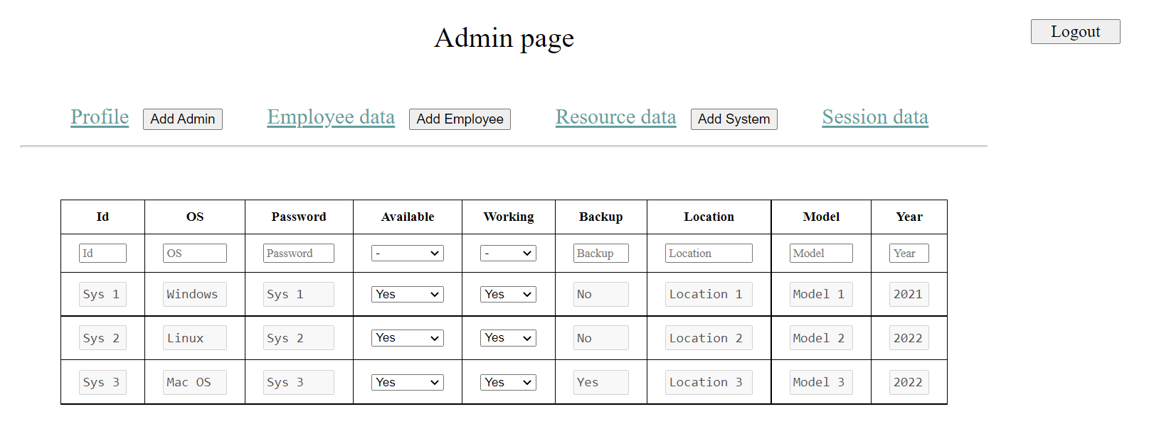
Admin – Resource data
Clicking on Resource data link displays list of systems in table format.
Availability and working status of each system can be changed from dropdown list. Note : Changing working status will automatically change availability status of system also. Availability status cannot be changed if working status if ‘No’

Slide 8
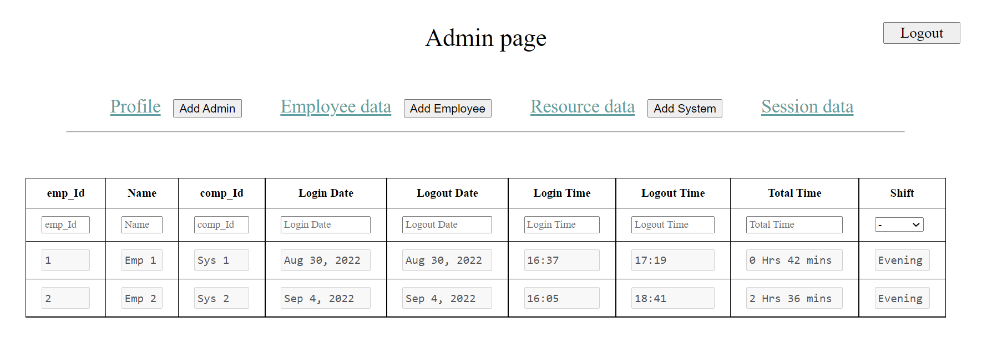
Admin – Session data
Clicking on Session data link will display all employee’s session details in table form. Session data is read-only no update or delete actions can be performed on session data from within the web app UI.

Slide 9
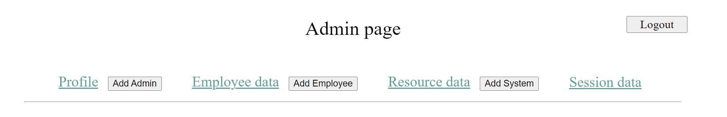
Registration
To add,
Add Admin – Button can be used which will open Admin registration form in new tab.
Add Employee - Button can be used which will open Employee registration form in new tab.
Add System - Button can be used which will open System registration form in new tab.
After clicking submit in registration form, previous data will be cleared so that new data can be entered. If data entered conforms to all the form validation conditions but if server doesn’t accept the data for some reason (e.g. Duplicate users) the tab will be automatically closed after alerting user.

Slide 10
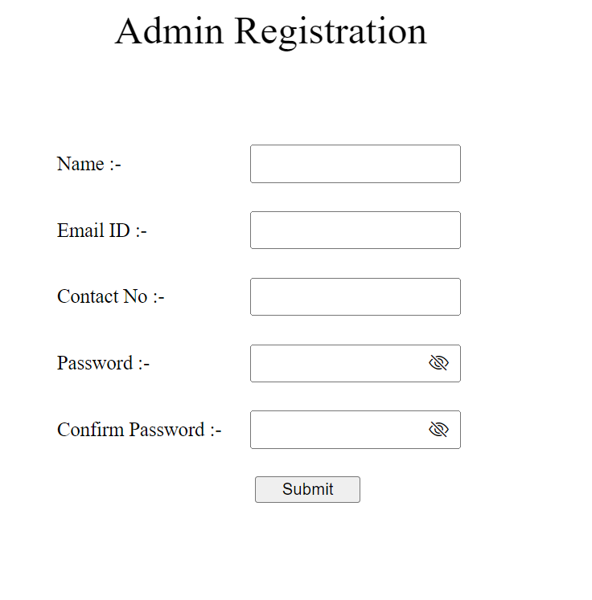
Admin Registration
All fields are mandatory.
Name can contain only spaces and characters.
Email should contain `@` and `.` and in that order.
Contact no should contain 10-digits only.
‘Confirm password’ must match ‘Password’ and should be of min length 4.

Slide 11
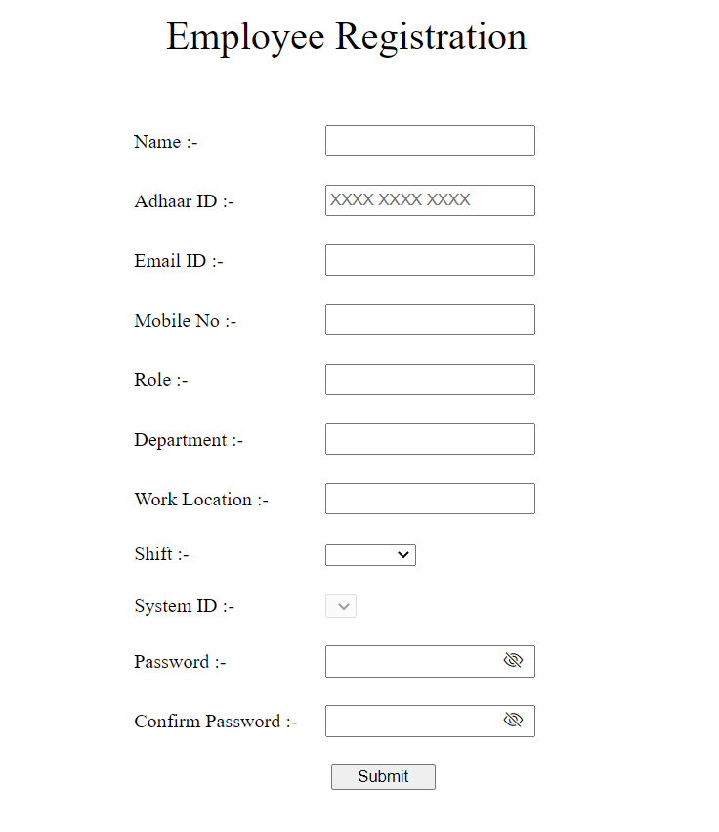
Employee Registration
All fields are mandatory except ‘System Id’.
Name can contain only spaces and characters.
Email should contain `@` and `.` and in that order.
Contact no should contain 10-digits only
When shift is chosen from drop-down list, list of unallocated systems excluding backup is fetched from database. System Id can be chosen from the list. If not chosen the first System in the list is automatically allocated to the employee.
‘Confirm password’ must match ‘Password’ and should be of min length 4.

Slide 12
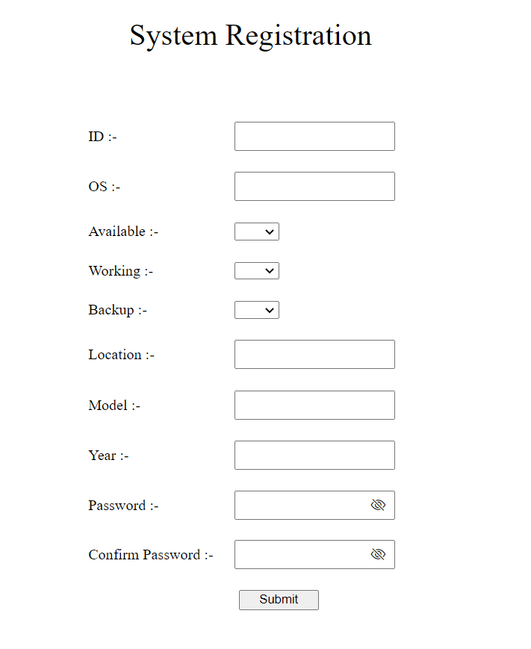
System Registration
All fields are mandatory except ‘Available’ and ‘Working’.
If ‘Availability’ is not selected, default is ‘Yes’.
If ‘Working’ is not selected, default is ‘Yes’. If ‘Working’ is ‘No’, ‘Available is ‘No’.
‘Confirm password’ must match ‘Password’ and should be of min length 4.

Slide 13
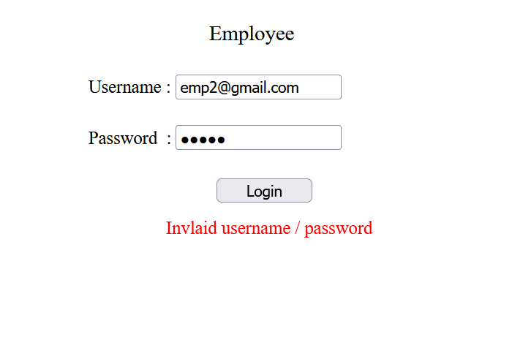
Employee Login
While typing password (if username is not empty) Employee’s allocated system id is displayed.
Clicking on login will prompt user to enter the ‘Computer Id’ (prompt only once within his/her shift)
Employee cannot login in shift/system other than which he/she is assigned to.
When incorrect username or password is entered error message is displayed in red.
When login credentials are correct Employee is redirected to Employee page and Employee ID is stored in session storage to identify who is currently logged in to the website using that particular web browser.

Slide 14
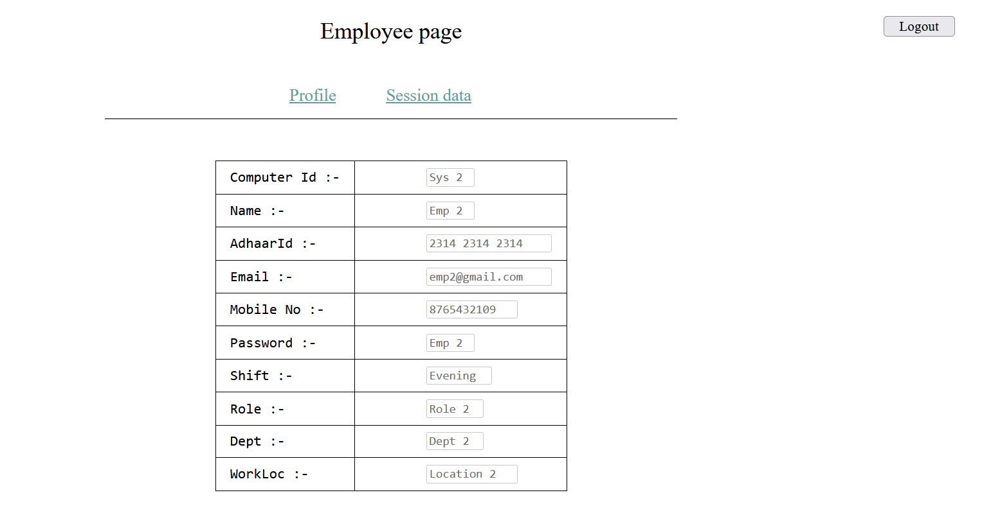
Employee page
Employee page shows their profile and session data. Employee page is shown after login or after refreshing the page.
During login / logout, session data of that user is updated in database.

Slide 15
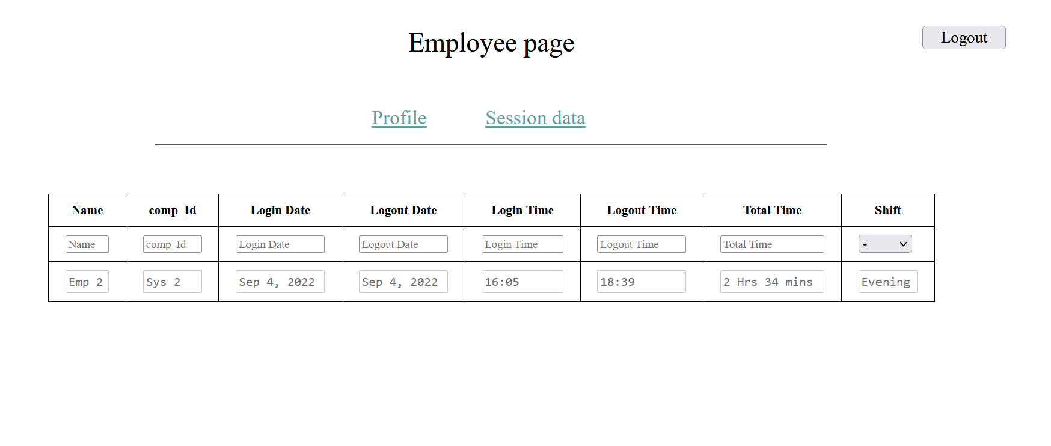
Employee – Session data
Clicking on Session data link will display employee’s session details in table form. Session data is read-only no update or delete actions can be performed on session data from within the web app UI.

Slide 16
Filter option
Employee :
System :
Session :

Slide 17
Filter
Filter option is present below each column name.
For values that belong in certain fixed set of finite values that never change, the type of filter option is dropdown list other wise the type is text box
For text box type filters,
On type – All records that includes filter text is shown
On pressing enter – All records that exactly match the filter text is shown

